Slide 1
What is a Parliamentarian, and what does a Parliamentarian do?
A parliamentary Short Take by Sally F. LaMacchia, Esq., PRP, based on Robert’s Rules of Order, Newly Revised

Slide 2
During a meeting, a working parliamentarian is usually present to assist the Presiding Officer’s efficient and fair handling of assembly business.
“At the same time, any presiding officer will do well to bear in mind that no rules can take the place of tact and common sense on the part of the chairman.”
RONR (12th ed.) § 47:6. p. 427
RONR 47:6 – This is the first reference listed in the RONR, Newly Revised index under Parliamentarian.

Slide 3
“The parliamentarian is a consultant …”. RONR (12th ed.) § 47:46
The President
Other Officers
Committees
Members
on
Matters of Parliamentary Procedure

Slide 4
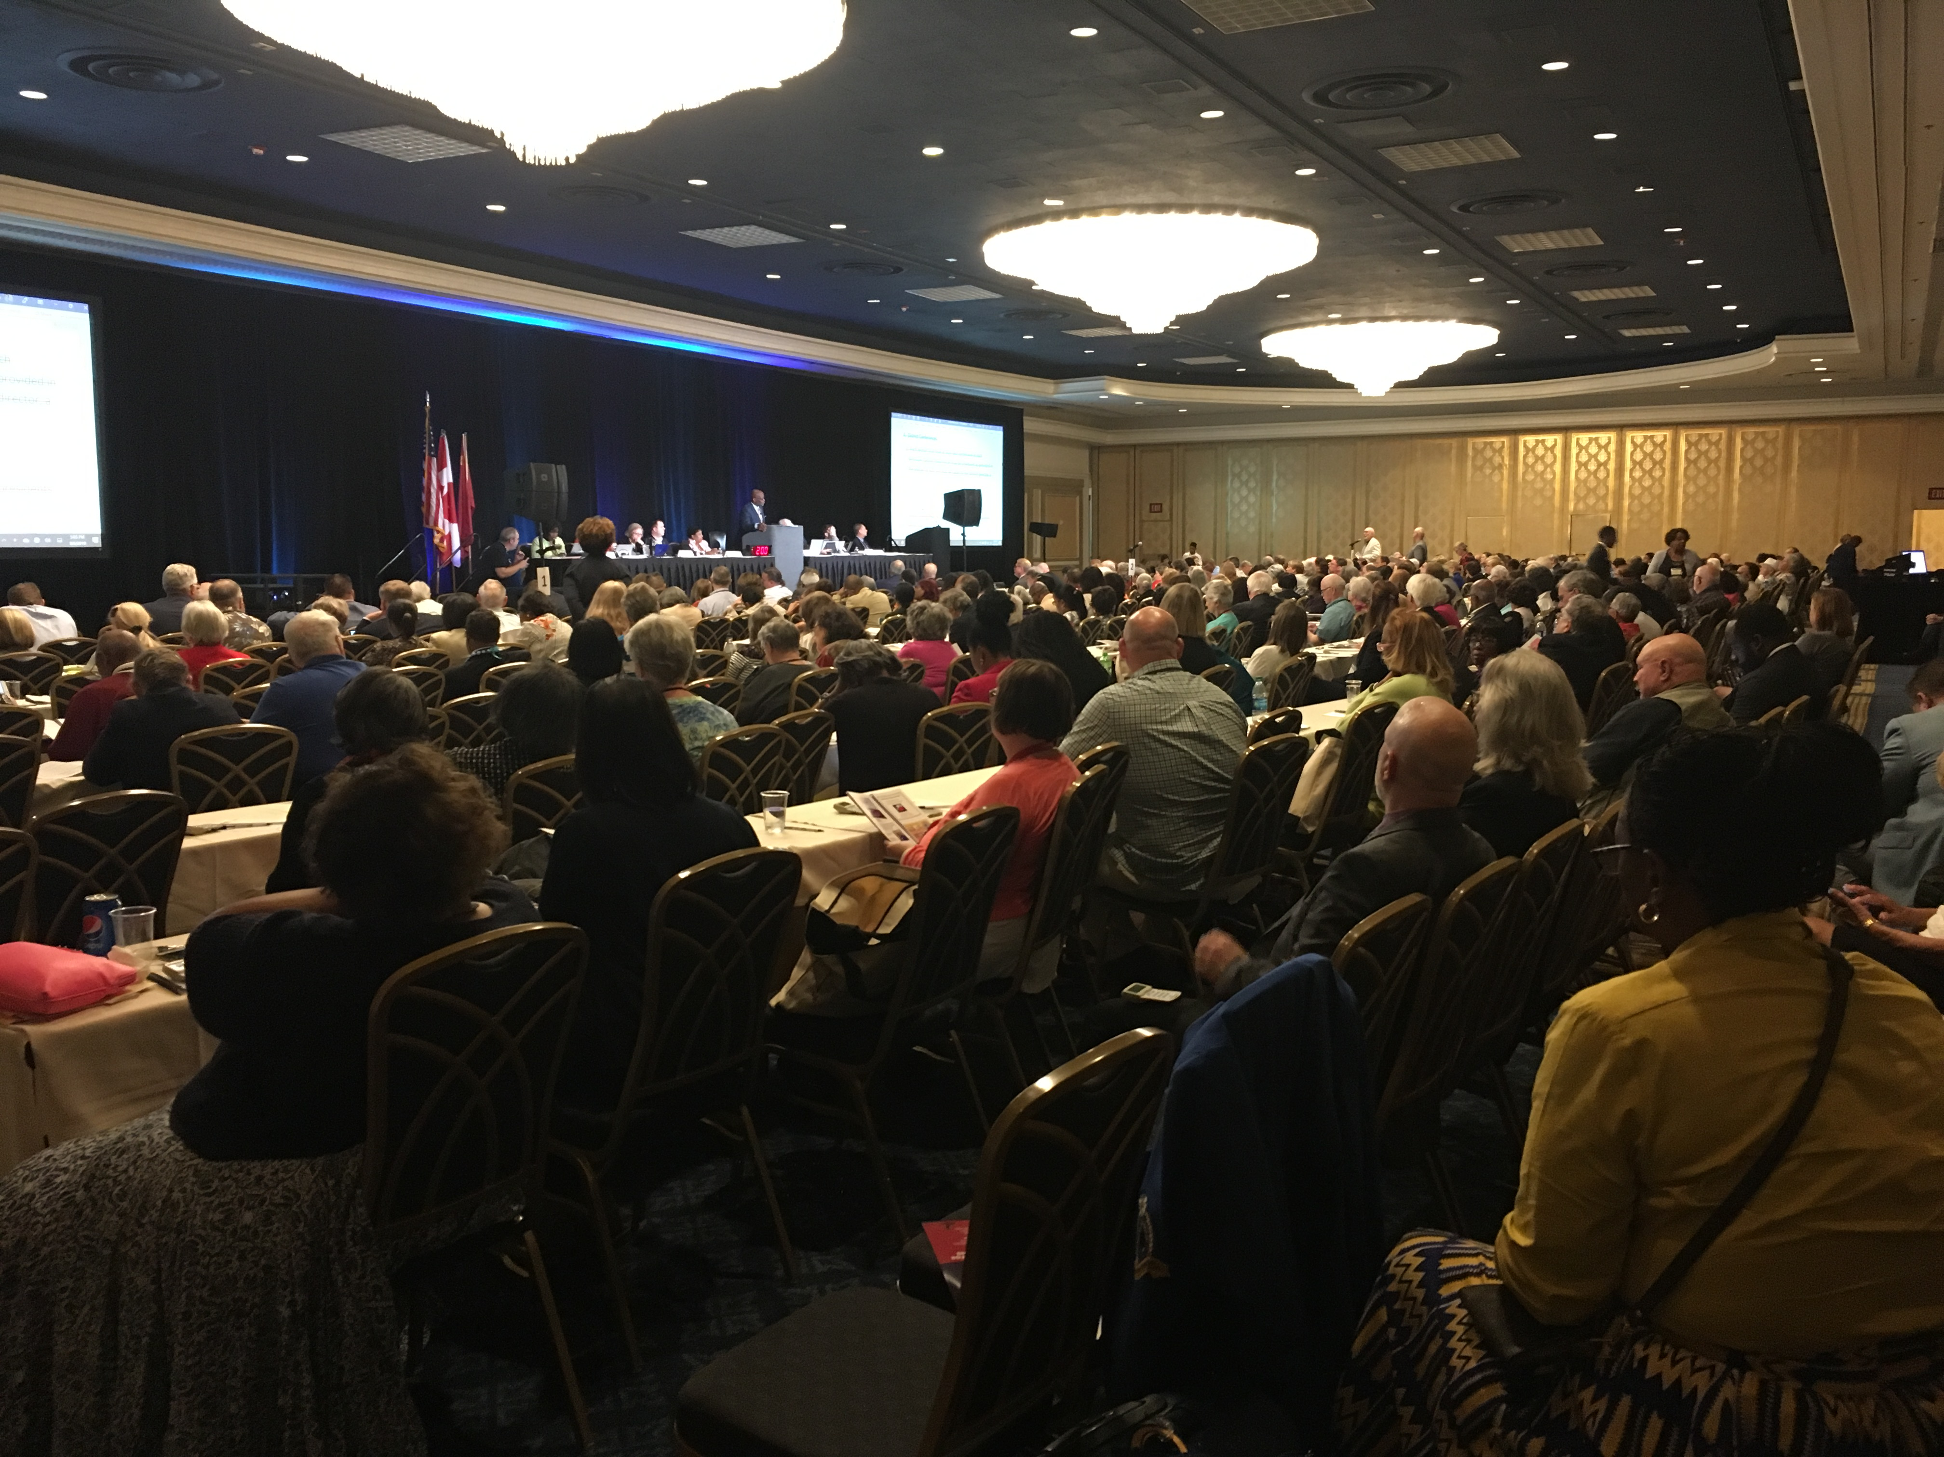
“... It is advisable to engage” a parliamentarian for –
Revision of Bylaws
A Large Assembly
A Convention
Complex Business
RONR (12th ed.) § 47:7

Slide 5
Parliamentarians are “employed throughout the year.” RONR (12th ed.) § 47:47
A State or National Organization
A board or committee of a State, National Organization
International Organization

Slide 6
“Elizabeth MacDonough is an American lawyer and Parliamentarian of the United States Senate since 2012. She is the first woman to hold the position.”
Source: Wikipedia

Slide 7
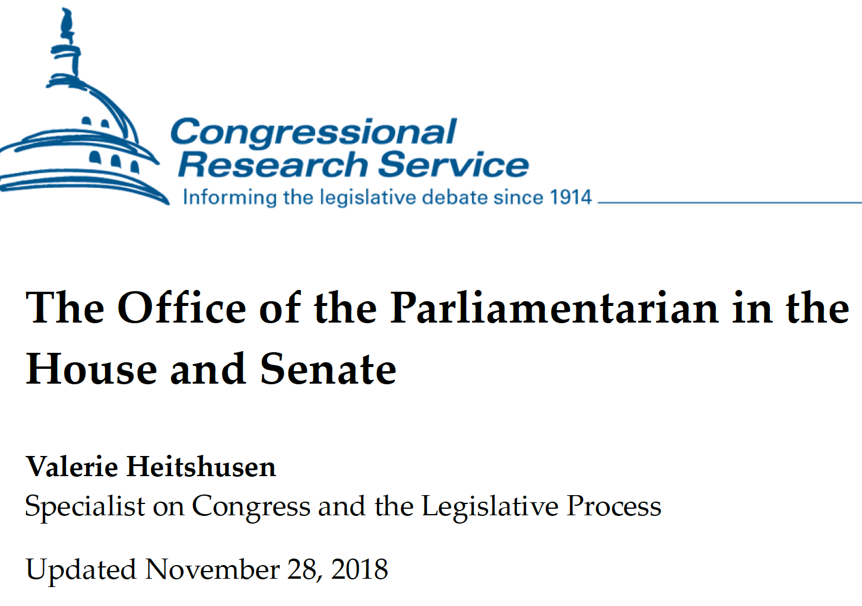
The Congressional Research Service report (3 pages) is on the CSAP Website under “Public Education”; the other was recently copied from senate.gov.

Slide 8
“If a parliamentarian is needed by an organization, the president should be free to appoint … one in whom she has confidence.”
RONR (12th ed.) § 47:48

Slide 9
“If a parliamentarian is needed by an organization, the president should be free to appoint one in whom she has confidence.”
RONR (12th ed.) § 47:48

Slide 10
“A member of an assembly who acts as its parliamentarian has the same duty as the presiding officer to maintain a position of impartiality, and therefore does not make motions, participate in debate, or vote on any question except in the case of a ballot vote.” RONR (12th ed.) § 47:55
SEE RONR NEWLY REVISED § 47:49-56 to review various “Duties of the parliamentarian.”

Slide 11
A parliamentary Short Take by Sally F. LaMacchia, Esq., PRP, based on Robert’s Rules of Order, Newly Revised Thank you for your attention. Brought to you by CSAP
What is a Parliamentarian, and what does a Parliamentarian do?”

