Slide 1
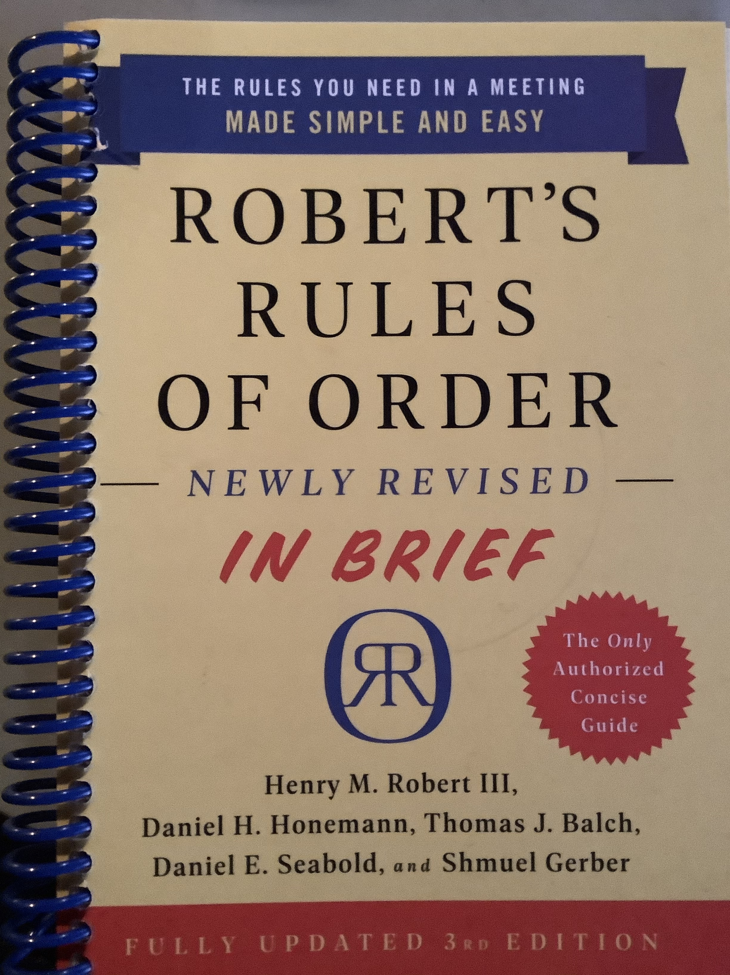
A Parliamentary Lesson based on RONR In Brief . Chapters 1 – 7
Brought to you by the California State Association of Parliamentarians
and
Sally F. LaMacchia, PRP, President, CSAP

Slide 2
Meeting Rules Are Adopted Chapter 1 WHY??
Group decision making is hard.
SPS: It might be the hardest thing you’ll ever do.
RONRIB says ”even a half dozen” gathered to make group decisions is challenging.
SPS: More than one demands special effort.
RONRIB points out that in a larger group (12-15) “a need for tighter, more formal, more carefully developed control” arises.

Slide 3
Meeting Rules Are Adopted WHY??
“Too many people may try to talk at once.”
“Some may not be able to get a word in edgewise.”
The discussion may veer off topic – way off topic!
Decisions made may not be understood by the group that made them.
These are serious problems that will undercut your organization from within.

Slide 4
I’m Going to a Meeting! Chapter 2 THE BASICS
The Chair will “keep order” during a meeting.
The Secretary will ”make a written record of what is done.”
The Quorum will prevent decision making “by an unrepresentatively small number of members” at a meeting.
Following a standard Order of Business ensures steady progress during the meeting.
Members must also “keep order” during a meeting.
“What [Business] Is Done” is recorded; not what is said.
”An organization specifies its quorum in the bylaws.”
Minutes
Reports
Unfinished Business
New Business

Slide 5
Chair: “The meeting will come to order.” Opening Ceremonies; Introductions “Because a majority of council members including the president are attending today, the chair declares a quorum.” An Example of what the Chair might say.

Slide 6
Chair: “The first item of business is approval of the minutes of the prior meeting. ”The Secretary will read the minutes.” The 01 12 2021 meeting minutes were distributed with this meeting notice. Are there any corrections to the minutes?” Chair: “Hearing no corrections, the minutes are approved as distributed.” RONRIB, p. 14

Slide 7
If corrections are needed, corrections are made. Member A: “Madam President?” Chair: “The Chair recognizes Member A.” Member A: “There is a typo is the name of Mr. LaMacchia. There is only 1 “c”.” Chair: “Thank you, Member A. The spelling of Mr. LaMacchia’s name will be corrected. Are there any further corrections to the minutes?”

Slide 8
Chair: “Hearing no further corrections, the minutes of the 01 12 2021 meeting are approved as corrected. ”

Slide 9
Chair: “THE NEXT ITEM OF BUSINESS IS REPORTS.”
President
Vice President
Secretary
Treasurer
Standing Committees (Chair)
Special Committees (Chair)
Order mentioned in the bylaws.
Chair’s Choice on Calling for Reports.
“In most societies it is customary to hear reports from all officers, boards, and standing committees only at annual meetings.” RONR (12th ed.) 41:13

Slide 10
Chair: “THE NEXT ITEM OF BUSINESS IS UNFINISHED BUSINESS AND GENERAL ORDERS.” RONRIB, p. 15
“Items of business, if any, carried over from the previous meeting.”
“The chair should bring these matters up automatically.”
The Chair might say,
“Under unfinished business, the first item of business is the motion to…, which was pending when the last meeting adjourned”.

Slide 11
Unfinished Business Was “in the process of being considered” or was “scheduled to come up at the last meeting” but didn’t.

Slide 12
Chair: Is there any new business?
Minutes
Reports
Unfinished Business
New Business
Members – along with the Chair - must also “keep order” during a meeting.
“What [Business] Is Done” is recorded; not what is said.
”An organization specifies its quorum in the bylaws.”

Slide 13
An AGENDA is an alternative to the Standard Order of Business Minutes Reports Unfinished Business New Business (An adopted AGENDA is “binding”.)

Slide 14
An AGENDA is an alternative to the Standard Order of Business Minutes Reports Unfinished Business New Business RECESS and STAND AT EASE One for the members, the other for the chair.

Slide 15
HOW YOU GET TO SPEAK AT A MEETING #1
Chapter 3 – How Decisions are Made
at a Meeting:
Handling Motions
“You stand up immediately after the previous speaker has finished and call out “Madam President”, “Mr. Chairman”, or whatever the chair’s title may be.”
RONRIB, p. 19

Slide 16
#2 You Wait for Recognition from the Chair
This is how members begin to work together to keep order during a meeting.
#3
You rise, precisely state your motion, and be seated.

Slide 17
“I move that the Tennis League establish a division open to juniors and seniors in city high schools.” p. 21
“Second!”
Important
Saves Time
More than One
But debate should not begin even on a seconded motion, until the Chair “states the question”, like this:
“It is moved and seconded that the Tennis League establish a division open to juniors and seniors in city high schools.”
and then the Chair says …

Slide 18
“Does the maker of the motion wish to speak to the motion?” And debate on the business at hand begins. p. 26 & 27

Slide 19
Can the Chair refuse to state the motion? Yes, if it is out of order or needs clarifying.

Slide 20
After debate, the Chair “Puts” the Question p. 24
When it appears that debate is over the Chair – to be sure - may ask, Are you ready for the question?, or Are you ready for the vote? If the assembly is ready, the Chair puts the question.
“The question is on the adoption of the motion that the Tennis League establish a division open to juniors and seniors in city high schools. Those in favor of the motion, say “aye”. Those opposed, say “no”.”

Slide 21
“The question is on the adoption of the motion that the Tennis League establish a division open to juniors and seniors in city high schools. This motion requires a majority vote in favor for adoption. Those in favor of the motion, say “aye”. Those opposed, say “no”.”
“The “ayes” have it, the motion is adopted, and the Tennis League will establish a division open to juniors and seniors in city high schools.
The next item of business is …”

Slide 22
Chapter 4 DEBATE p. 28
YOU
may “speak in debate twice on any debatable motion”, each time “for up to ten minutes.”
WHAT?!
Twenty minutes per person on every debatable motion?
Imagine that?
You can’t save time, redistribute time, or give your time to someone else.

Slide 23
After the Maker of the Motion, Who Gets to Speak Next? p. 33
Fairness
Reasonableness
Someone who has not yet spoken.
Someone who wishes to speak on the other side of the issue.

Slide 24
Let’s Vote Already! p.37
P. 34 Limit or Extend Debate
“I move
the previous question.”
P. 35-37

Slide 25
AMENDMENTS Chapter 5 p. 38
INSERT WORDS p. 40
STRIKE OUT WORDS p. 42
STRIKE OUT AND INSERT WORDS p. 44
ADD WORDS
ADD A PARAGRAPH p. 47
STRIKE OUT A PARAGRAPH p. 47
SUBSTITUTE p. 47

Slide 26
SECONDARY AMENDMENTS “Amending Amendments” p. 49
Primary Amendment
(Proposed Change to Main Motion)
Secondary Amendment
(Proposed Change to Primary Amendment)
M1 [after obtaining the floor]:
“I move that the club offer caps and scots from our table at a discounted rate.”
.
M2 [after obtaining the floor]:
“I move to amend by striking caps and inserting scones.”
M3: Second!
M4: Madam President!
Chair: Yes, M4? (The Chair recognizes M4.)
M4: I move to amend by striking scones and inserting totes.
M1: Second!

Slide 27
AMENDMENTS Germaneness The Settled Rule p. 50
Germaneness
The “Settled” Rule
“Closely related to or having bearing on the subject of the motion to be amended.” RONR (12th ed.) § 12:6
Beyond Amendments - RELATED TO WHAT WAS JUST THERE.
Debate is germane to the question at hand; secondary is germane to primary; strike is germane to insert.
The basic rule is that after the group has voted to take certain action, it is not in order to revisit that issue/action again at the same meeting.
The matter is “Settled” for now.

Slide 28
Chapter 6 p. 52 Postpone to a Certain Time Commit or Refer Populating Committees
STANDING COMMITTEES AND SPECIAL COMMITTEES

Slide 29
POSTPONE (Indefinitely) & POSTPONE TO A CERTAIN TIME p. 53
An adopted motion to “postpone” avoids a vote on the question “for the duration of that session”. “Its adoption kills the main motion.” Debate on the motion to postpone may go into the merits of the main motion. RONR (12th ed.) § 11:1
An adopted motion to “postpone to a certain time” postpones the vote until a time certain identified in the motion itself. Debate is limited to whether postponement is or is not a good idea, and if so, for how long. Debate may not go into the merits of the main motion.

Slide 30
Commit or Refer
Identify the committee: Standing Committee (in the bylaws), or Special Committee (created as needed).
Instruct the committee: what to do, when to report.
Populate the committee: If not specified in the bylaws, then by appointment, or by naming members.
“Madam President, I move that a committee of 3 be appointed by the Vice-President to draft a proposed Mission Statement and schedule for the Fall Assembly, and that the committee report at the Council Meeting in August.”
RONRIB p. 55
A motion to commit or refer is adopted “so that the question may be carefully investigated and put into better condition for the assembly to consider.” § 13

Slide 31
Reconsider and Renew – and Correcting Mistakes How Can a Group Change Its Mind? Chapter 7 P. 57
Ground Rules:
× Once a thing is decided, it is done for the rest of that meeting or session.
× It takes more support to change a thing than to do it in the first place.
Reconsider
One who did not vote on the losing side of proposal may seek to revisit an item of business with a motion to reconsider a previous vote, which must be made on the same day the vote was taken or on the next day within a session.
Rescind or Amend Something Previously Adopted
Any member, anytime. Two-thirds vote for adoption or majority with previous notice of “the complete substance of the proposed change.” RONR (12th ed.) § 35:2(7)

Slide 32
How Can a Group Change Its Mind? Chapter 7 P. 57
Ground Rules:
× Once a thing is decided, it is done for the rest of that meeting or session.
× It takes more support to change a thing than to do it in the first place.
Renewal of Motions
Each new meeting presents a second bite at the apple. “Making a motion again after it has been defeated is called renewal of the motion.”
p. 62
One more thing …

Slide 33
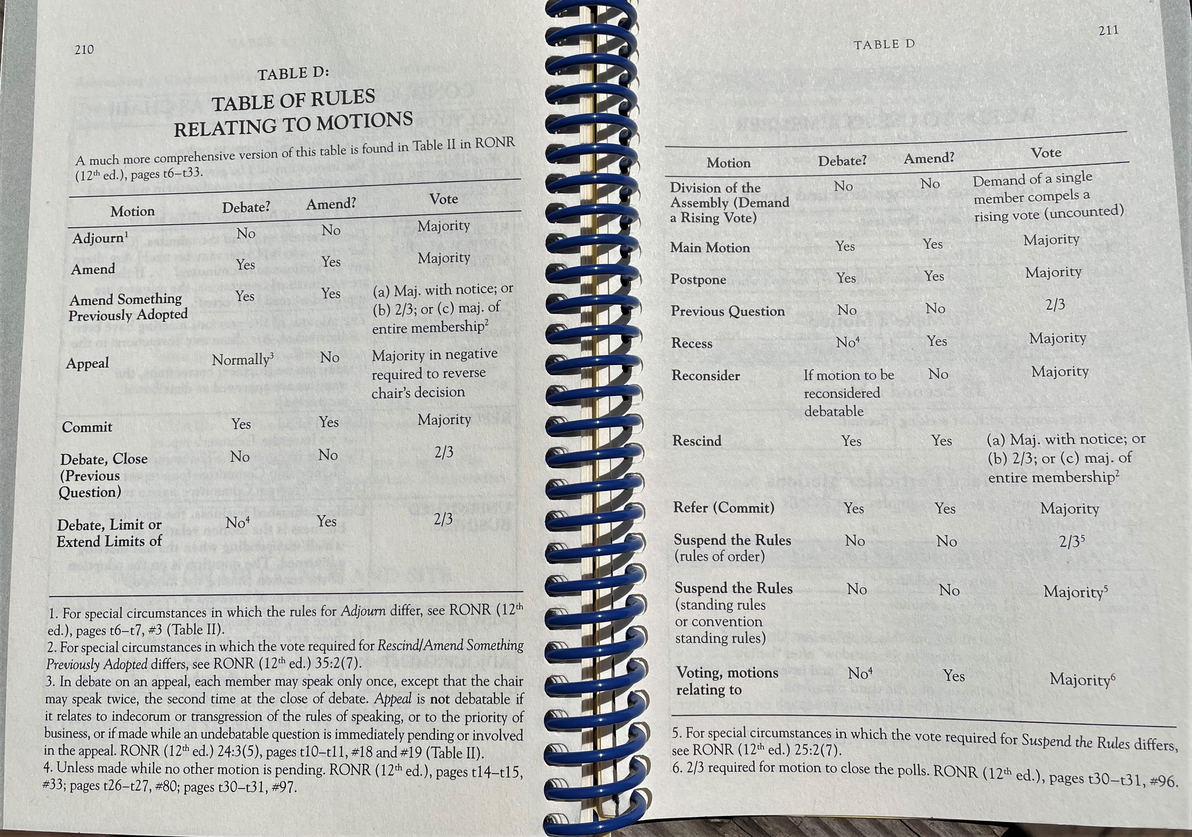

Slide 34
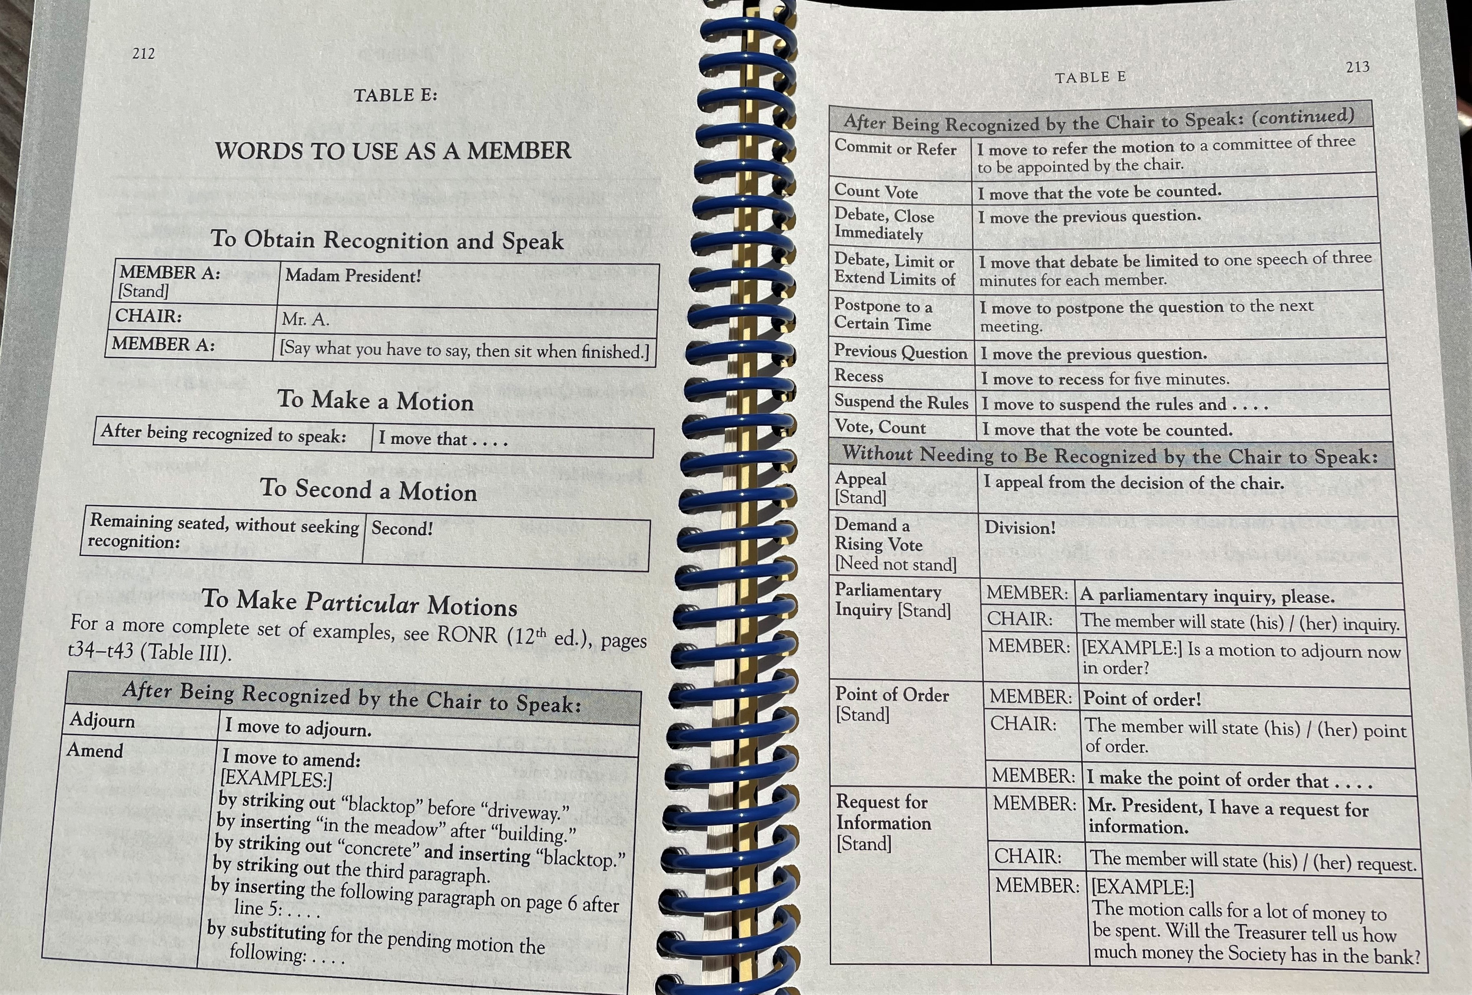

Slide 35
This concludes a Parliamentary Lesson based on Chapters 1 – 7 RONRIB
Brought to you by the California State Association of Parliamentarians
and
Sally F. LaMacchia, PRP, President, CSAP

