Slide 1
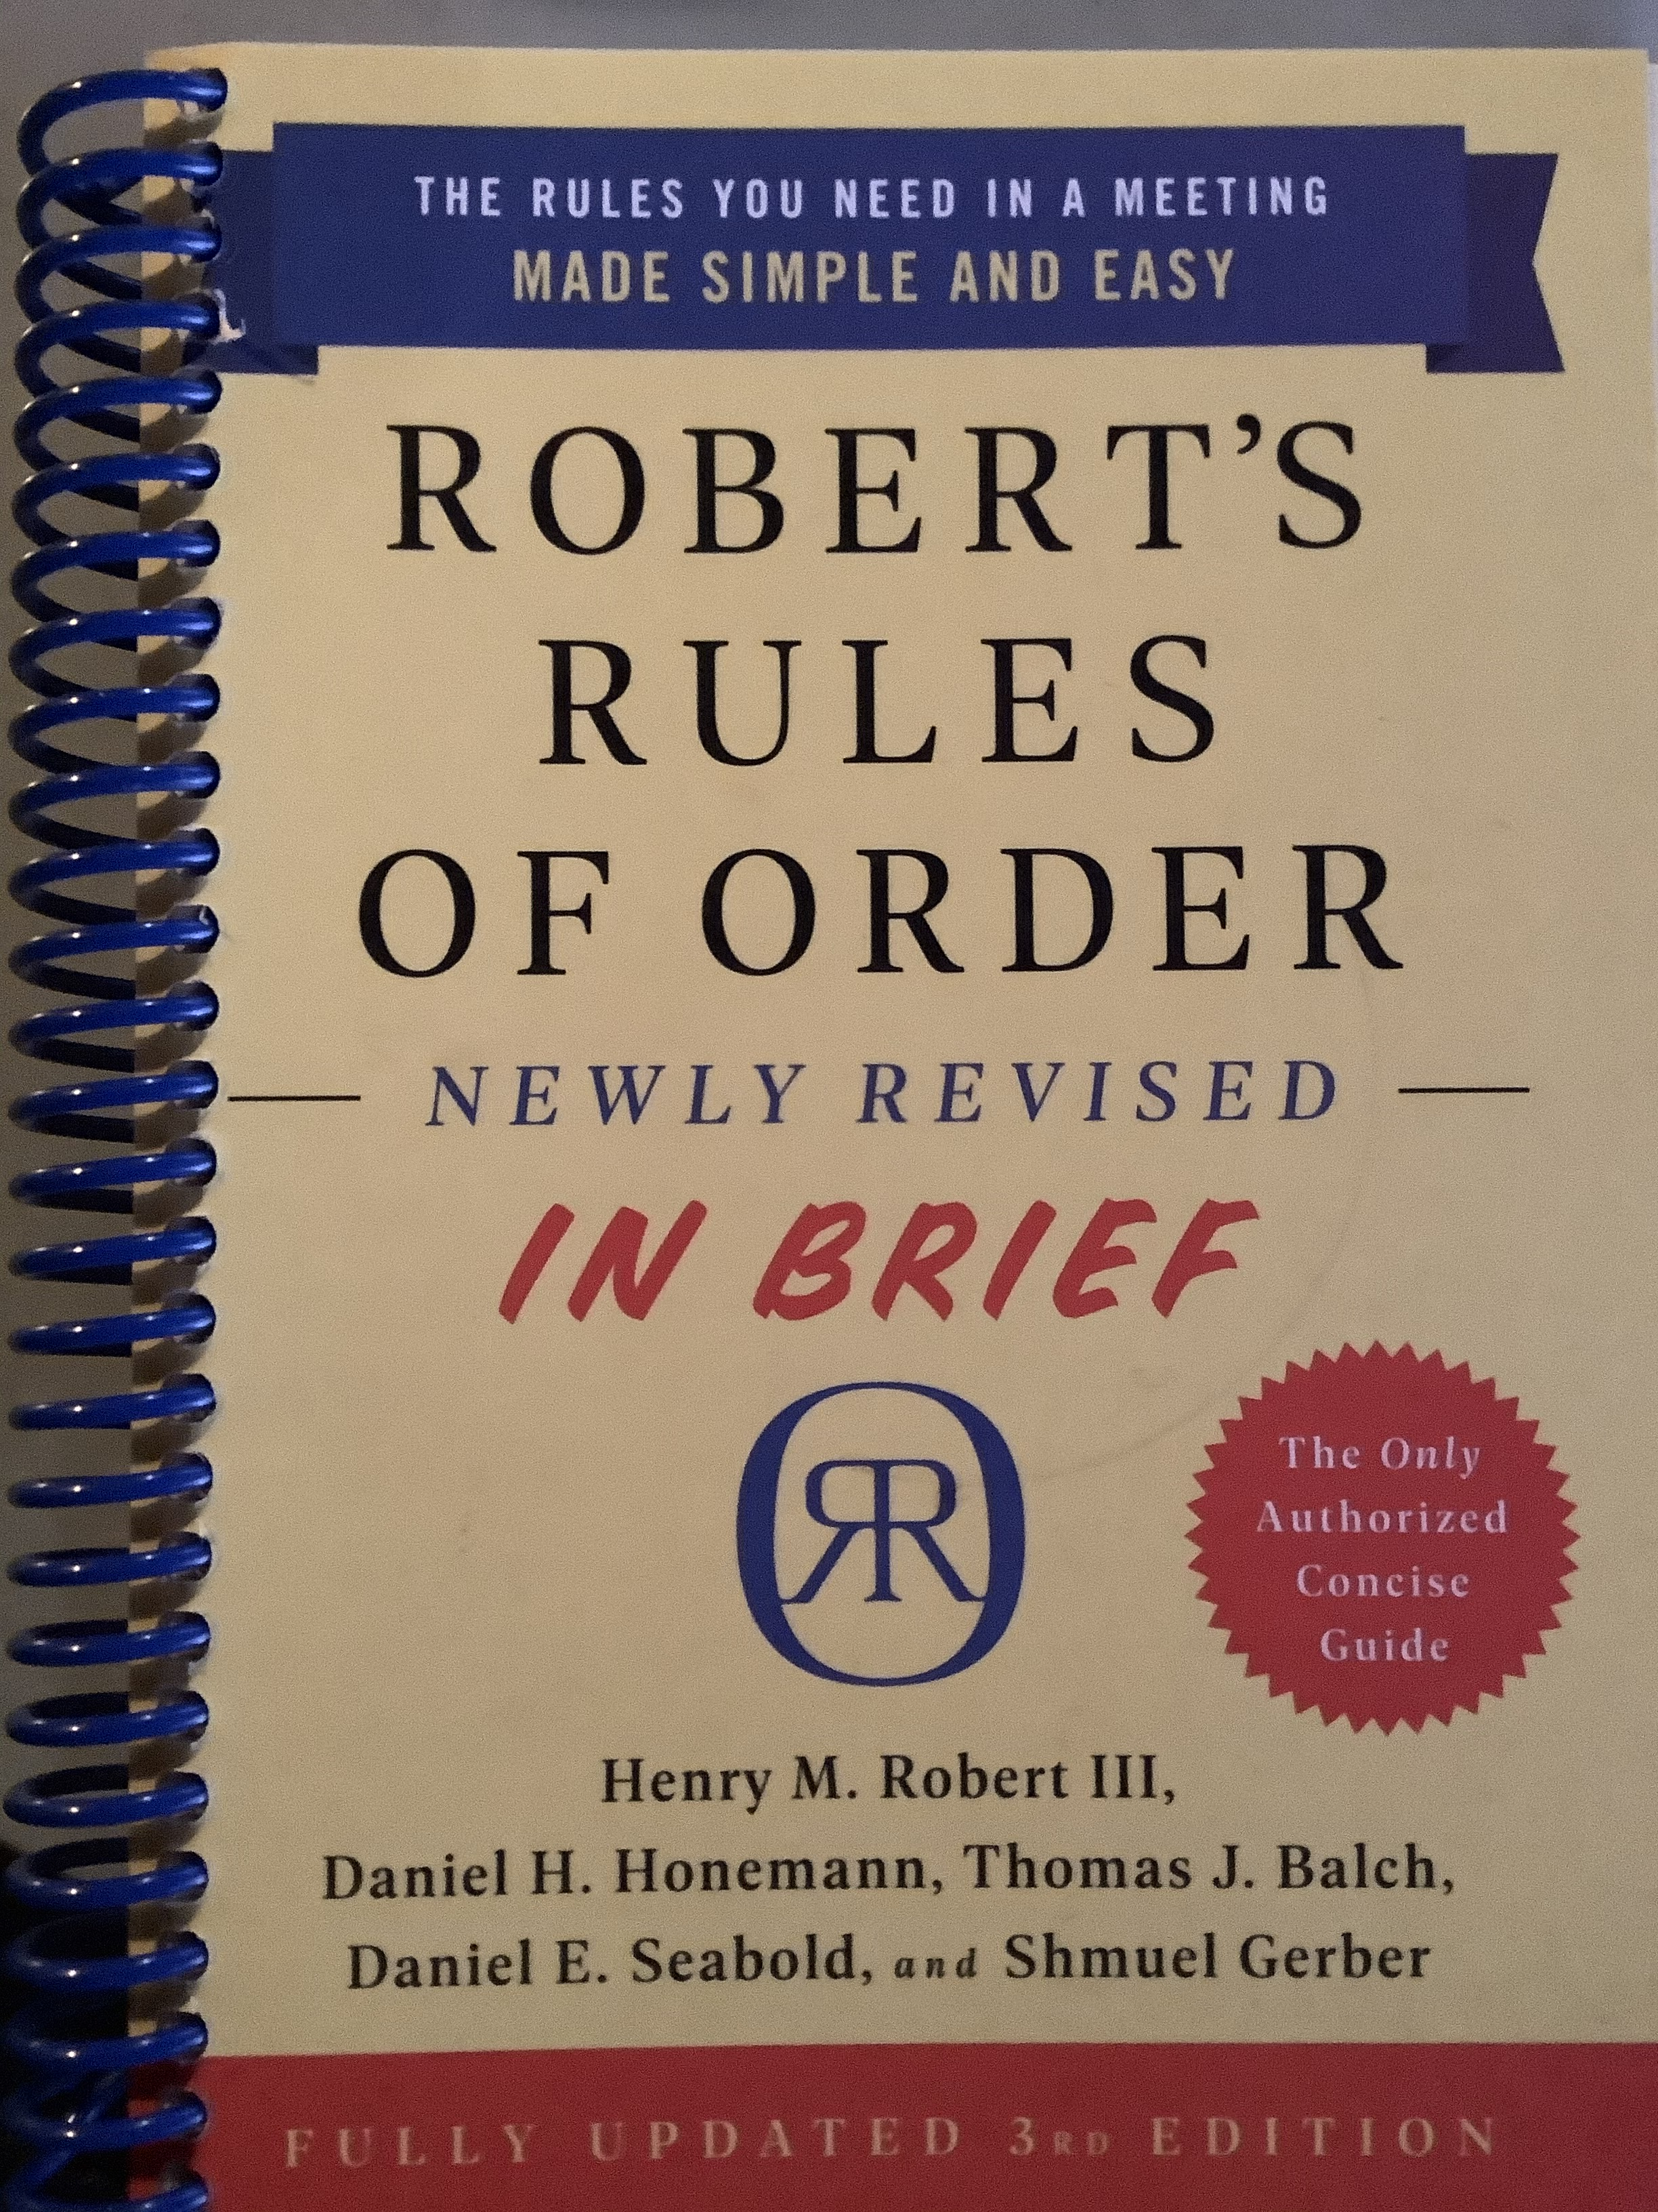
A Parliamentary Lesson based on RONR In Brief . Chapters 1 – 7 & 8-11
Brought to you by the California State Association of Parliamentarians
and
Sally F. LaMacchia, PRP, President, CSAP

Slide 2
Meeting Rules Are Adopted Chapter 1 WHY??
Group decision making is hard.
It might be the hardest thing you’ll ever do.
RONRIB says ”even a half dozen” gathered to make group decisions is challenging.
More than one demands special effort.
RONRIB points out that in a larger group (12-15) “a need for tighter, more formal, more carefully developed control” arises.

Slide 3
Meeting Rules Are Adopted WHY??
“Too many people may try to talk at once.”
“Some may not be able to get a word in edgewise.”
The discussion may veer off topic – way off topic!
Decisions made may not be understood by the group that made them.
These are serious problems that will undercut your organization from within.

Slide 4
I’m Going to a Meeting! Chapter 2 THE BASICS
The Chair will “keep order” during a meeting.
The Secretary will ”make a written record of what is done.”
The Quorum will prevent decision making “by an unrepresentatively small number of members” at a meeting.
Following a standard Order of Business ensures steady progress during the meeting.
Members must also “keep order” during a meeting.
“What [Business] Is Done” is recorded; not what is said.
”An organization specifies its quorum in the bylaws.”
Minutes
Reports
Unfinished Business
New Business

Slide 5
Chair: “The meeting will come to order.” Opening Ceremonies; Introductions “Because a majority of council members including the president are attending today, the chair declares a quorum.” An Example of what the Chair might say.

Slide 6
Chair: “The first item of business is approval of the minutes of the prior meeting. ”The Secretary will read the minutes.” The 01 12 2021 meeting minutes were distributed with this meeting notice. Are there any corrections to the minutes?” Chair: “Hearing no corrections, the minutes are approved as distributed.” RONRIB, p. 14

Slide 7
If corrections are needed, corrections are made. Member A: “Madam President?” Chair: “The Chair recognizes Member A.” Member A: “There is a typo is the name of Mr. LaMacchia. There is only 1 “c”.” Chair: “Thank you, Member A. The spelling of Mr. LaMacchia’s name will be corrected. Are there any further corrections to the minutes?”

Slide 8
Chair: “Hearing no further corrections, the minutes of the 01 12 2021 meeting are approved as corrected. ”

Slide 9
Chair: “THE NEXT ITEM OF BUSINESS IS REPORTS.”
President
Vice President
Secretary
Treasurer
Standing Committees (Chair)
Special Committees (Chair)
Order mentioned in the bylaws.
Chair’s Choice on Calling for Reports.
“In most societies it is customary to hear reports from all officers, boards, and standing committees only at annual meetings.” RONR (12th ed.) 41:13

Slide 10
Chair: “THE NEXT ITEM OF BUSINESS IS UNFINISHED BUSINESS AND GENERAL ORDERS.” RONRIB, p. 15
“Items of business, if any, carried over from the previous meeting.”
“The chair should bring these matters up automatically.”
The Chair might say,
“Under unfinished business, the first item of business is the motion to…, which was pending when the last meeting adjourned”.

Slide 11
Unfinished Business Was “in the process of being considered” or was “scheduled to come up at the last meeting” but didn’t.

Slide 12
Chair: Is there any new business?
Minutes
Reports
Unfinished Business
New Business
Members – along with the Chair - must also “keep order” during a meeting.
“What [Business] Is Done” is recorded; not what is said.
”An organization specifies its quorum in the bylaws.”

Slide 13
An AGENDA is an alternative to the Standard Order of Business Minutes Reports Unfinished Business New Business (An adopted AGENDA is “binding”.)

Slide 14
An AGENDA is an alternative to the Standard Order of Business Minutes Reports Unfinished Business New Business RECESS and STAND AT EASE One for the members, the other for the chair.

Slide 15
HOW YOU GET TO SPEAK AT A MEETING #1
Chapter 3 – How Decisions are Made
at a Meeting:
Handling Motions
“You stand up immediately after the previous speaker has finished and call out “Madam President”, “Mr. Chairman”, or whatever the chair’s title may be.”
RONRIB, p. 19

Slide 16
#2 You Wait for Recognition from the Chair
This is how members begin to work together to keep order during a meeting.
#3
You rise, precisely state your motion, and be seated.

Slide 17
“I move that the Tennis League establish a division open to juniors and seniors in city high schools.” p. 21
“Second!”
Important
Saves Time
More than One
But debate should not begin even on a seconded motion, until the Chair “states the question”, like this:
“It is moved and seconded that the Tennis League establish a division open to juniors and seniors in city high schools.”
and then the Chair says …

Slide 18
“Does the maker of the motion wish to speak to the motion?” And debate on the business at hand begins. p. 26 & 27

Slide 19
Can the Chair refuse to state the motion? Yes, if it is out of order or needs clarifying.

Slide 20
After debate, the Chair “Puts” the Question p. 24
When it appears that debate is over the Chair – to be sure - may ask, Are you ready for the question?, or Are you ready for the vote? If the assembly is ready, the Chair puts the question.
“The question is on the adoption of the motion that the Tennis League establish a division open to juniors and seniors in city high schools. Those in favor of the motion, say “aye”. Those opposed, say “no”.”

Slide 21
“The question is on the adoption of the motion that the Tennis League establish a division open to juniors and seniors in city high schools. This motion requires a majority vote in favor for adoption. Those in favor of the motion, say “aye”. Those opposed, say “no”.”
“The “ayes” have it, the motion is adopted, and the Tennis League will establish a division open to juniors and seniors in city high schools.
The next item of business is …”

Slide 22
Chapter 4 DEBATE p. 28
YOU
may “speak in debate twice on any debatable motion”, each time “for up to ten minutes.”
WHAT?!
Twenty minutes per person on every debatable motion?
Imagine that?
You can’t save time, redistribute time, or give your time to someone else.

Slide 23
After the Maker of the Motion, Who Gets to Speak Next? p. 33
Fairness
Reasonableness
Someone who has not yet spoken.
Someone who wishes to speak on the other side of the issue.

Slide 24
Let’s Vote Already! p.37
P. 34 Limit or Extend Debate
“I move
the previous question.”
P. 35-37

Slide 25
AMENDMENTS Chapter 5 p. 38
INSERT WORDS p. 40
STRIKE OUT WORDS p. 42
STRIKE OUT AND INSERT WORDS p. 44
ADD WORDS
ADD A PARAGRAPH p. 47
STRIKE OUT A PARAGRAPH p. 47
SUBSTITUTE p. 47

Slide 26
SECONDARY AMENDMENTS “Amending Amendments” p. 49
Primary Amendment
(Proposed Change to Main Motion)
Secondary Amendment
(Proposed Change to Primary Amendment)
M1 [after obtaining the floor]:
“I move that the club offer caps and scots from our table at a discounted rate.”
.
M2 [after obtaining the floor]:
“I move to amend by striking caps and inserting scones.”
M3: Second!
M4: Madam President!
Chair: Yes, M4? (The Chair recognizes M4.)
M4: I move to amend by striking scones and inserting totes.
M1: Second!

Slide 27
AMENDMENTS Germaneness The Settled Rule p. 50
Germaneness
The “Settled” Rule
“Closely related to or having bearing on the subject of the motion to be amended.” RONR (12th ed.) § 12:6
Beyond Amendments - RELATED TO WHAT WAS JUST THERE.
Debate is germane to the question at hand; secondary is germane to primary; strike is germane to insert.
The basic rule is that after the group has voted to take certain action, it is not in order to revisit that issue/action again at the same meeting.
The matter is “Settled” for now.

Slide 28
Chapter 6 p. 52 Postpone to a Certain Time Commit or Refer Populating Committees
STANDING COMMITTEES AND SPECIAL COMMITTEES

Slide 29
POSTPONE (Indefinitely) & POSTPONE TO A CERTAIN TIME p. 53
An adopted motion to “postpone” avoids a vote on the question “for the duration of that session”. “Its adoption kills the main motion.” Debate on the motion to postpone may go into the merits of the main motion. RONR (12th ed.) § 11:1
An adopted motion to “postpone to a certain time” postpones the vote until a time certain identified in the motion itself. Debate is limited to whether postponement is or is not a good idea, and if so, for how long. Debate may not go into the merits of the main motion.

Slide 30
Commit or Refer
Identify the committee: Standing Committee (in the bylaws), or Special Committee (created as needed).
Instruct the committee: what to do, when to report.
Populate the committee: If not specified in the bylaws, then by appointment, or by naming members.
“Madam President, I move that a committee of 3 be appointed by the Vice-President to draft a proposed Mission Statement and schedule for the Fall Assembly, and that the committee report at the Council Meeting in August.”
RONRIB p. 55
A motion to commit or refer is adopted “so that the question may be carefully investigated and put into better condition for the assembly to consider.” § 13

Slide 31
Reconsider and Renew – and Correcting Mistakes How Can a Group Change Its Mind? Chapter 7 P. 57
Ground Rules:
× Once a thing is decided, it is done for the rest of that meeting or session.
× It takes more support to change a thing than to do it in the first place.
Reconsider
One who did not vote on the losing side of proposal may seek to revisit an item of business with a motion to reconsider a previous vote, which must be made on the same day the vote was taken or on the next day within a session.
Rescind or Amend Something Previously Adopted
Any member, anytime. Two-thirds vote for adoption or majority with previous notice of “the complete substance of the proposed change.” RONR (12th ed.) § 35:2(7)

Slide 32
How Can a Group Change Its Mind? Chapter 7 P. 57
Ground Rules:
× Once a thing is decided, it is done for the rest of that meeting or session.
× It takes more support to change a thing than to do it in the first place.
Renewal of Motions
Each new meeting presents a second bite at the apple. “Making a motion again after it has been defeated is called renewal of the motion.”
p. 62
One more thing …

Slide 33
This concludes a Parliamentary Lesson based on Chapters 1 – 7 RONRIB
Brought to you by the California State Association of Parliamentarians
and
Sally F. LaMacchia, PRP, President, CSAP

Slide 34
A Parliamentary Lesson based on RONR In Brief . Chapters 8 – 9 – 10 - 11
Brought to you by the California State Association of Parliamentarians
and
Sally F. LaMacchia, PRP, President, CSAP

Slide 35
Chapter 8 VOTING p.65
MAJORITY VOTE
A Majority of Those Present and Voting
TWO-THIRDS VOTE
The prevailing side has 2x as many votes as the losing side.
“A majority vote is normally required …”.
.
A majority of those present and voting.
.
Majority - more than half.
Suspend the Rules
Limit Debate
Close Debate (I move the Previous Question!)
Object to Consideration of the Question
Close Nominations
Amend Adopted Agenda

Slide 36
Majority of the ENTIRE MEMBERSHIP ”is an allowable alternative.”
This vote requirement “is frequently an alternative to a requirement of previous notice and is required in order to rescind and expunge from the minutes.

Slide 37
“Unanimous consent enables … some action to be taken … with out the necessity of having the chair … put the motion to a vote.” RONRIB p. 68 ”The chair simply asks the assembly is there is any objection to taking the desired action.” RONRIB p. 68 In a group accustomed to working together, the chair might say, “Without objection, …”.
UNANIMOUS CONSENT
p. 68

Slide 38
MEMBERS RIGHT to Vote
ANY MEMBER NOT UNDER DISCIPLINARY SUSPENSION HAS THE RIGHT TO VOTE EVEN IF DUES ARE UNPAID AND EVEN IF THE MEMBER HAS A CONFLICT OF INTEREST.
The Chair votes when the vote is by ballot, or when her vote affects the outcome.
The Chair is a neutral. The Chair does not make motions. The Chair does not participate in debate.
CHAIR ‘s
RIGHT to Vote

Slide 39
1. Standing (uncounted) a. 2/3 vote b. indeterminate voice vote c. Division 2. Show of Hands “In a small group a show of hands may be used.” 3. Counted Chair’s choice, or a motion to count is adopted. 4. Ballot – a secret vote. Conducted, counted by Tellers, whose report is entered into the minutes.
MORE METHODS
OF
VOTING
P. 70
Roll Call Vote, Mail In Vote

Slide 40
Nominations and Elections Chapter 9 p. 77
NOMINATIONS: From the Floor
By a Nominating Committee
ELECTIONS: Commonly conducted by ballot
If just one candidate, by acclamation

Slide 41
Nominations From the Floor By a Nominating Committee
These are “the two most common means” of nominating a candidate for office.
From the floor:
The Chair says: “Nominations are now in order for the office of _______________.”
Any member may then call out, “I nominate Ms. Jones.”
When appropriate, the Chair says, “Are there any further nominations? If not, nominations are closed.” No motion is needed to close nominations.
From the Nominating Committee:
Committee members are elected; the committee nominates one or more than one candidates for each office, after securing each nominees consent to serve. After the committee’s report, the Chair asks for further nominations from the floor.

Slide 42
ELECTIONS p. 79
Commonly conducted by ballot.
Only one candidate? Often by acclimation.
BYLAWS GOVERN
Write in candidates are part of vote by ballot.
Write in candidates need not have been nominated.
If no candidate receives a majority, balloting continues until a majority is achieved.
The election is final when the result is announced by the Chair and the winning candidate does not decline immediately when told of the election results.
A candidate takes office as soon as the election becomes final.

Slide 43
PART IV Bylaws and Other Rules and How to Use Them CHAPTER 10
LAW
CORPORATE CHARTER
BYLAWS OR CONSTITUTION
RULES OF ORDER
STANDING RULES
CUSTOM

Slide 44
LAW CORPORATE CHARTER BYLAWS OR CONSTITUTION RULES OF ORDER STANDING RULES CUSTOM
What the state or federal government says. It rules. RONR says a board decision must
result from a proper meeting; some laws say its OK to talk with members separately.
Has the do with the law of the state of incorporation. Varies state by state. Applies only to incorporated entities.
BYLAWS the governing rules of most organizations. i. Purpose ii. Members iii. Officers, Committees, and Meetings iv. Board of Directors or Executive Board.
Proposals in conflict with the bylaws are out of order.
Rules for the Conduct of Meetings – almost entirely the same from group to group. P.86
Special rules of order supersede any conflicting rule in the adopted parliamentary authority.
Amendment requires previous notice and a 2/3 vote.
Standing rules cover administrative matters of less significance as well as matters of decorum. “Guest shall be entered by first and last name into a Guest Register.”
Custom is habit. It refers to how we’ve always done it. No matter how old the custom, when in conflict with it, custom must always yield to the written rule.
WANT MEMBERS TO PARTICIPATE? PROVIDE A COPY OF OR ACCESS TO THE RULES – ALL OF THEM.

Slide 45
How are Rules Enforced and How Are They Suspended?
Chapter 11, p. 89

Slide 46
Point of Order and A P P E A L p.90 – 91 A Chairs Best Friend
“The chair has the duty of making sure that the rules are followed. Any member may call the attention the chair to a violation of the rules.”

Slide 47
Point of Order – Presiding is Deciding
A
B
M1: “Point of order!”
Chair: “The member will state her point.”
M1: “Madam President, the motion just passed on a majority vote to limit debate requires a 2/3 vote for adoption.”
Chair: “The point is well taken. The vote on the motion to limit debate will be taken again and needs 2/3rds in the affirmative to adopt.
Those in favor of [the motion to limit debate], say “aye”; those opposed, say “no.”
M1: “Point of order!”
Chair: “The member will state her point.”
M1: “Madam President, the motion just passed on a 2/3 vote to limit debate requires a majority vote for adoption.”
Chair: “The point is not well taken. Two-thirds vote is required to adopt a motion to limit debate. The next order of business is ….
M1: “I appeal from the decision of the chair!”
M2: “Second!”

Slide 48
M1:“I appeal from the decision of the chair!” M2:“Second!”
MUST BE TIMELY – right now
Debatable*, but members may speak only once.
Chair may speak 2x, first & last.
Debatable* unless question involved in the appeal is not debatable.
Chair
“The decision of the chair has been appealed.”
“Shall the decision of the chair be sustained?”
A majority vote in the negative is needed to overrule the chair.
“A tie [vote] sustains the decision of the chair and loses the appeal.” RONRIB, p. 91
Much as the call of an exasperated member to “stop talking and vote!!” is in fact a parliamentary motion for “The Previous Question”, so too,
an appeal from the decision of the chair can often appear in unrecognizable form to the untrained ear. A parliamentarian knows that an argument over a decision by the chair is in parliamentary fact an appeal from that decision, just as surely as “LETS VOTE!” is a motion to cease debate and proceed to an immediate vote on the pending question[s].

Slide 49
“There are times when you wish to do something forbidden by the rules.” RONRIB, p. 93
Move to Suspend the Rules
Needs a second and
A two-thirds vote
No debate
“I move to suspend the rules -
(state the reason)
- to allow the Recreation Committee to report at this time.”

Slide 50
If you have a question, ask the chair saying (for example): “A parliamentary inquiry please.”
PARLIAMENTARY
INQUIRY
PARLIAMENTARIAN’S ROLE
Chair
“The member will state the inquiry.”

Slide 51
WHAT IS THE PENDING QUESTION?
“The Chair has the duty of responding to such questions.”
p. 95
Such questions are known as a “Parliamentary Inquiry”.
If your inquiry requires immediate attention, you may interrupt (need not wait for recognition) t0 say, “A parliamentary inquiry, please.”
“The Chair has the duty of resp0nding … to assist.”
The assistance given by the Chair is not a ruling and not subject to appeal.
If a member feels strongly that the Chair is wrong, RONRIB points out the member may “act contrary” to the Chair and in that way force an appealable ruling.

Slide 52
OTHER EXAMPLES OF A PARLIAMENTARY INQUIRY
Member A: Madam President, I rise to parliamentary inquiry. [Or, “A parliamentary inquiry, please.”]
Chair “The Member will state the inquiry.”
Member A: Is it in order at this time to move the previous question? [Or “Can we take a VOTE now?]
OR
Member B: Mr. Chairman, will the convention delegates report at this meeting?
OR
Member C: Madam President, this motion requires a large expenditure. Will the treasurer state the present balance?
OR
Member D: Madam President, will the member yield for a question?
OR
Member E: Mr. President, I would like to ask the speaker a question.
THE CHAIR IS NOT OBLIGED TO ANSWER HYPOTHETICAL QUESTIONS
THE CHAIR’S RESPONSE IS NOT A RULING AND IS NOT SUBJECT TO APPEAL.
IF A MEMBER WANTS TO APPEAL CONDUCT OF THE CHAIR, THE MEMBER MUST FIND A WAY TO RAISE A POINT OF ORDER WHICH IS THEN APPEALED.

Slide 53
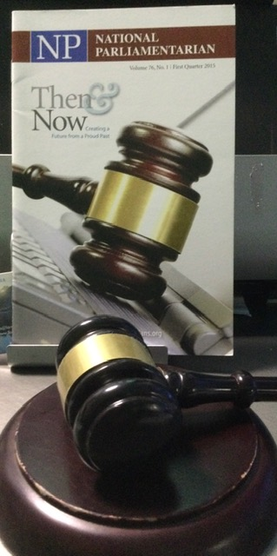
Advise the president on the conduct of the meeting. Is seated next to the presiding officer. Role is “purely advisory.” Rarely called to address the body.
The Parliamentarian’s Role

Slide 54
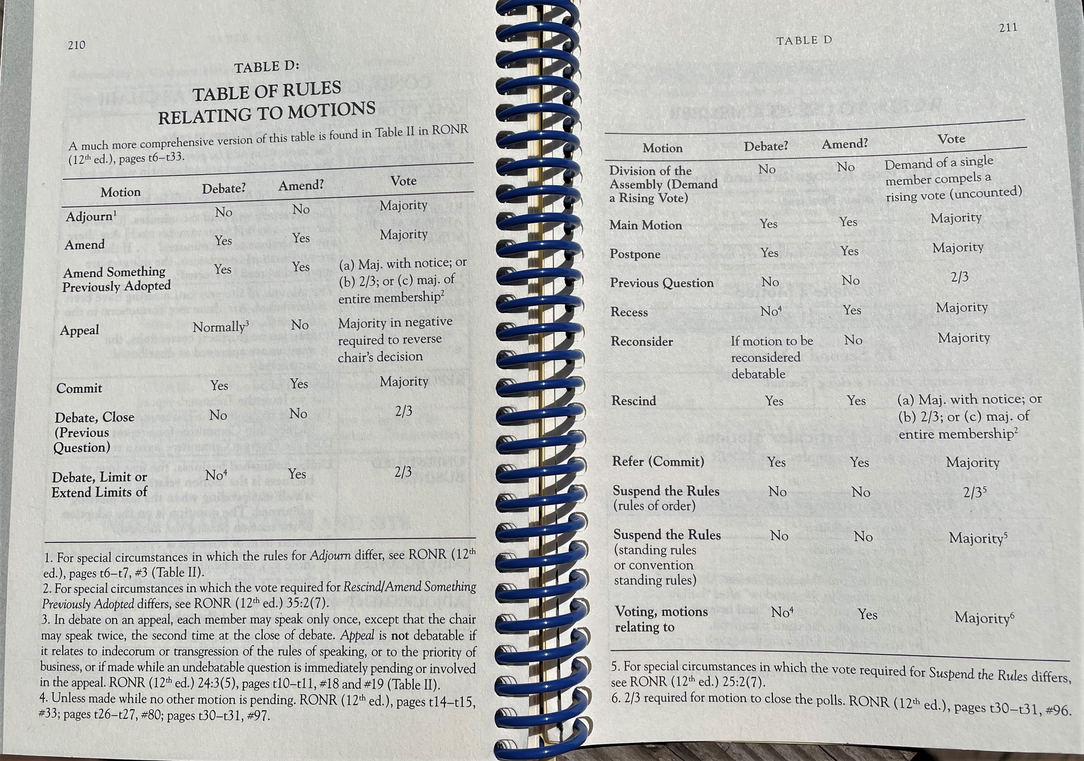

Slide 55
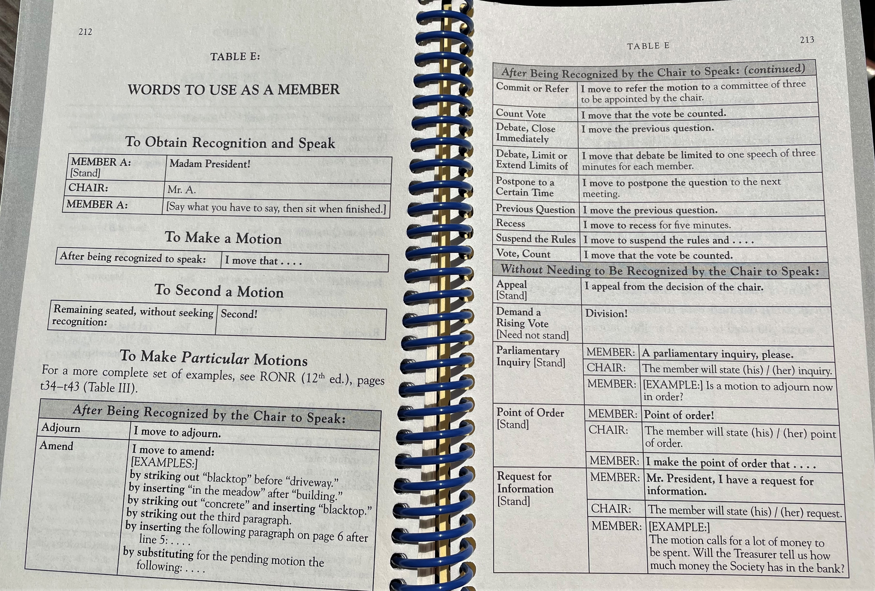

Slide 56
This concludes a Parliamentary Lesson based on Chapters 1 – 11 RONRIB
Brought to you by the California State Association of Parliamentarians
and
Sally F. LaMacchia, PRP, President, CSAP

